Slide 1
Simple Touch Prediction With Built-In IMUs
Felix Bühler, Benedict Steuerlein
FaPra Machine Learning and Computer Vision for HCI | Pfaffenwaldring 5a | 06.11.18
Notes:
We are F and B an our subject is Simple Touch Prediction with built in IMUs

Slide 2
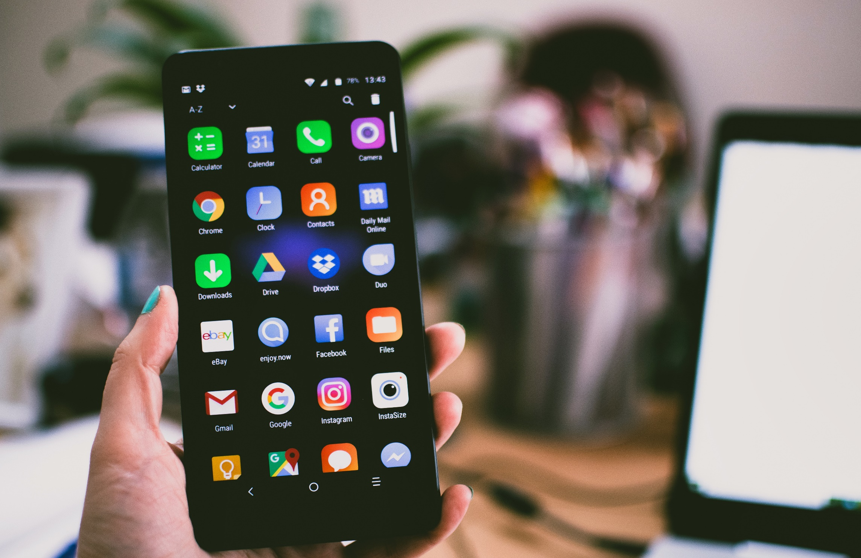
Smartphone sizes are increasing steadily
Whole front screen can not be reached without changing the grip
Predict where users want to touch
Notes:
FELIX
Nowadays smartphones are steadily increasing in size.
The whole area of the front screen cannot be reached without changing the initial grip.
What we actually want is to predict where users are going to touch
For example with the given information about a future touch we can preload a website, or enlarge certain areas

Slide 3
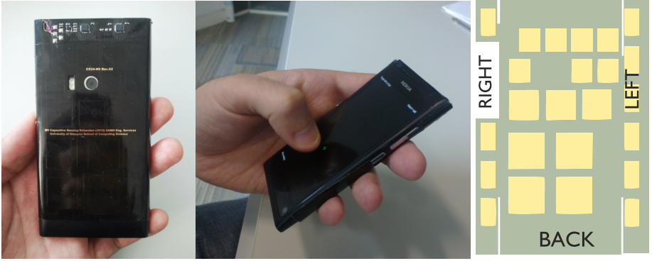
Related Work
24 sensors on Back-of-Device (BoD)
Grip shift on BoD to predict front-of-screen targeting
Mohd Noor, M. F., Ramsay, A., Hughes, S., Rogers, S., Williamson, J., & Murray-Smith, R. 28 frames later: predicting screen touches from back-of-device grip changes. In Proc. of SIGCHI ’14 ACM.
DOI: http://dx.doi.org/10.1145/2556288.2557148
Notes:
BENE
They used 24 sensors on the BoD and the laterals to detect grip shifts.
With Gaussian Process Regression they were able to predict with some accuracy where the users wanted to tap

Slide 4
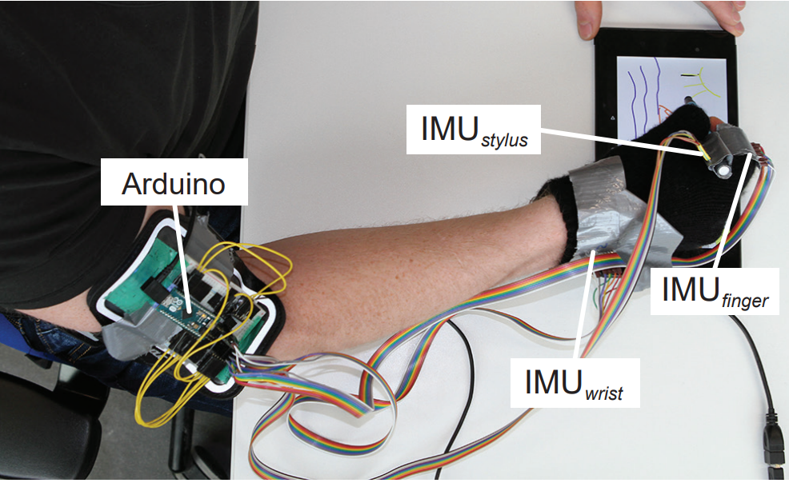
Related Work
Combination of neural network and external IMU
Predict future positions of writing trajectory
Reduce input latency on touch screens
Le, H. V., Schwind, V., Göttlich, P., & Henze, N.. PredicTouch: A System to Reduce Touchscreen Latency using Neural Networks and Inertial Measurement Units. In Proc. of ACM ‘17 International Conference on Interactive Surfaces and Spaces. DOI: http://dx.doi.org/10.1145/3132272.3134138
Notes:
FELIX
This paper is about PredicTouch, a system to predict future positions of the touch trajectory on touchscreens.
Touchscreens have a noticable latency between touching and drawing
With the help of a multi-layer feedforward neural network and inertial measurement units attached to the users arm they were able to predict future positions of the writing trajectory.

Slide 5
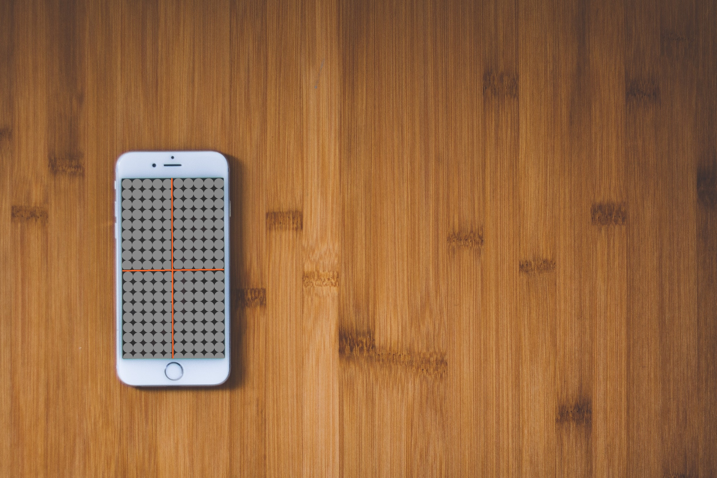
Project Plan
Data collection study
Training of a LSTM
Evaluation app
Notes:
BENE
Data collection study
15-20 right-handed participants performing x touches in 4 quadrants on the front side of the phone
3 different sized smartphones
Measurment with IMU‘s
FELIX
LSTM Network
Time series based data
LongtermShortTermMemory Network
BENE
Evaluation Study
App that shows based on IMU data the quadrant the user intended to press

Slide 6
Agenda
Nov
Dez
Jan 2019
Feb
Heute
Discussion
11/6/2018
11/13/2018
2018
11/13/2018
Android App
11/27/2018
Data Collection Study
11/28/2018
12/11/2018
8 Tage
12/11/2018
Network Training
1/8/2019
Discussion
15 Tage
1/8/2019
1/15/2019
14 Tage
1/15/2019
Evaluation
1/29/2019
Paper Revision
29 Tage
1/29/2019
2/5/2019
8 Tage
11/27/2018
Writing Paper
2/5/2019
15 Tage
8 Tage
71 Tage
Notes:
FELIX
This is our agenda.
Our first step is the discussion where we want to explore further steps in our app design.
Then we are going to develop the app
Then we want to carry out the data collection study
Next we are going to train our network for one month
We discuss our results
Then evaluate the results with the help of a evaluation app
During the whole process we are going to write our paper and revisit it in the last week

Slide 7
Questions
Data acquisition:
How big should the targets be?
How to treat targets close to the cross?
Study:
How many participants?
How many phones?
Notes:
BENE
We prepared some questions:
For the aquisition of the data:
How big should the targets be and connected to that how many targets should be in each quadrant?
How do we treat targets that are close to the cross, because we think they will result in false negative classifications
For our study:
How many participants shall we recruit?
How many phones should we use?

